Slide 1

Primrose Healthcare Application
Madhura Indurkar
Soham joshi
Rachitha meda
Annapurneshwari sheela shivaraj

Slide 2
OUTLINE
1
CLIENT INTRODUCTION
2
OBJECTIVE
3
APPLICATION
4
SCENERIO
5
SUMMARY
6
QUESTIONS

Slide 3

CLIENT INTRODUCTION
Primrose solutions is located in Tampa, Florida
Provides computer programming services such as computer software design and analysis
Group purchasing organizations helps healthcare providers-such as hospitals and nursing homes realize savings and efficiencies
By aggregating purchasing volume and using that leverage to negotiate discounts with manufacturers, distributors and other vendors

Slide 4
OBJECTIVE
Procurement
Marketing
Database Administration
To create a user friendly dashboard for the client organization.
This dashboard should facilitate integration and manipulation of database.
Also implement additional functionality based on database.

Slide 5
Applications of the System
Procurement
Place order for various facilities
Modify order before it has been shipped
Marketing
Illustrate cost saving for facilities
Compare savings with other facilities
Database administration
Add new items based on facilities and categories
Modify/delete existing items in the database

Slide 6
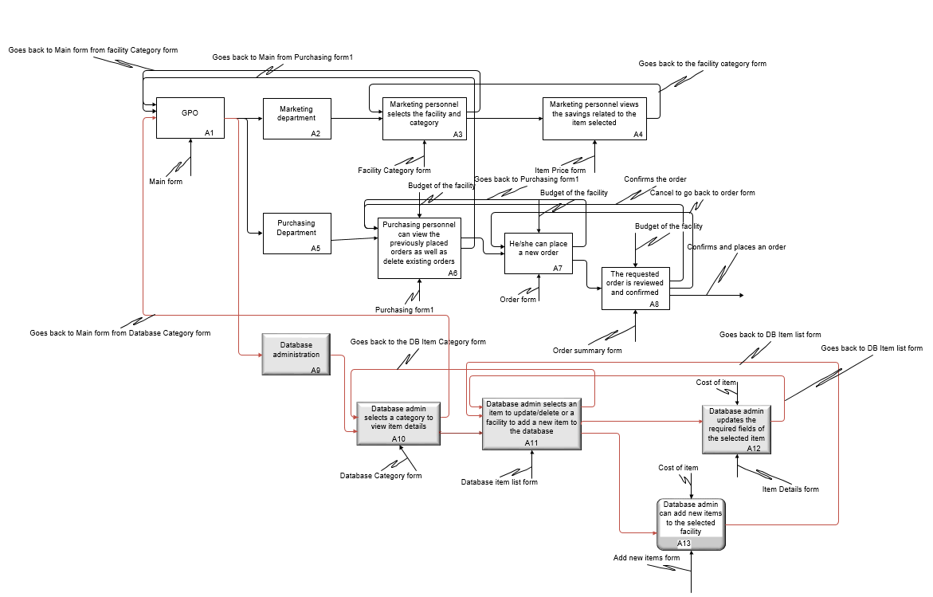

Slide 7
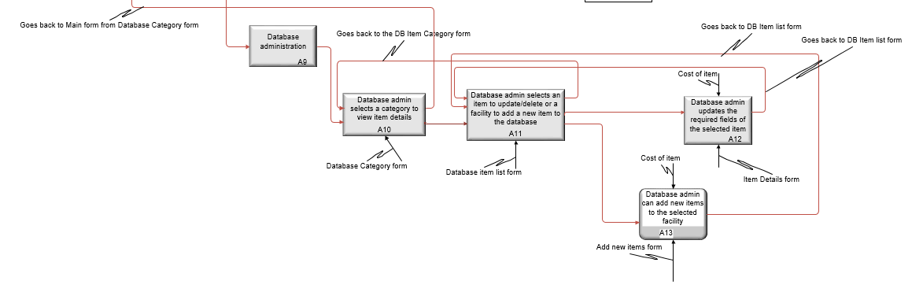

Slide 8
SCENARIO Database Management
Main form
Add items
Update items
Delete Items
Select category
Select facility
Select items and add to DB
Select category
Select items to update
Select category
Select items and Delete

Slide 9
SUMMARY
Development of a user interactive dashboard by Primrose Solutions to access the items inventory databases of three healthcare facilities of– UVM, Maimonides, Centrastate.
The dashboard can perform additional functionalities specific to the department of the healthcare facility- Purchasing, Marketing and Database Management.
Easy-to-use tool to Manage items inventory, Place and Modify orders, Compare Prices between facilities, Add or edit items in the Databases.
Our dashboard provides an effective solution for Purchasing, Cost Evaluation and Inventory Management of Healthcare facilities.

Slide 10
Questions

